Slide 1


Green Pace
Security Policy Presentation
Developer: Tam Phan

Slide 2

OVERVIEW: DEFENSE IN DEPTH
An organization should configure multiple layers of security and protocols effectively for immediate response against cyber threat; in order to minimize and mitigate the risk of intrusion

Slide 3
THREATS MATRIX
From L1 P12-P27 indicates high severity to L3 P1-P4 with low severity. The cost of expense to repair flaws is disproportionally with the severity and priority
Likely INT32-C STR38-C EXP34-C | Priority STR38-C P27 EXP34-C P18 FIO34-C P12 INT32-C P9
Low priority OOP53-CPP L3 DCL60-CPP L3 FIO51-CPP L3 ERR57-CPP L3 INT50-CPP L3 | Unlikely OOP53-CPP DCL60-CPP FIO51-CPP

Slide 4
10 PRINCIPLES
1. Validate Input Data
2. Heed Compiler Warning
3. Architect and Design for Security Policies
4. Keep It Simple
5. Default Deny
6. Adhere to the Principle of Least Privilege
7. Sanitize Data Sent to Other Systems
8. Practice Defense in Depth
9. Use Effective Quality Assurance Techniques
10. Adopt a Secure Coding Standard

Slide 5
CODING STANDARDS
1. Do not cast an out-of-range enumeration value
2. Ensure that operations on signed integers do not result in overflow
3. Do not confuse narrow and wide character strings and functions
4. Distinguish between characters read from a file and EOF or WEOF
5. Do not leak resources when handling exceptions
6. Do not dereference null pointers
7. Handle All Exceptions
8. Write constructor member initializers in the canonical order
9. Obey the one-definition rule
10. Close file when they are no longer needed
- Most coding mistake is resulted in undefined behavior or abnormal termination can make the affect the stability of the application and lead to more security vulnerabilities.

Slide 6
ENCRYPTION POLICIES
Encryption at rest: Data stored in the database behind firewall. Using AES(Advanced Encryption Standard) to encrypt data at rest to verify the key between sender and receiver so data can be readable
Encryption at flight: Data transmitted over the network. Using TLS (Transport Layer Security) or SSL (Secure Sockets Layers) to encrypt the communication between client and server, and prevent man in the middle attacks
Encryption in use: Data used in application. Using symmetric encryption such as AES, DES, or Triple DES or asymmetric encryption such as RSA to protect sensitive data.

Slide 7
TRIPLE-A POLICIES
Authentication: To confirm the user’s identity for system access such as user login and password
Authorization: To ensure user have right to access specific resources of the system such as file access permissions based on their level of privilege
Accounting: To track user’s activities accordingly in order to prevent any odd behavior in the future

Slide 8
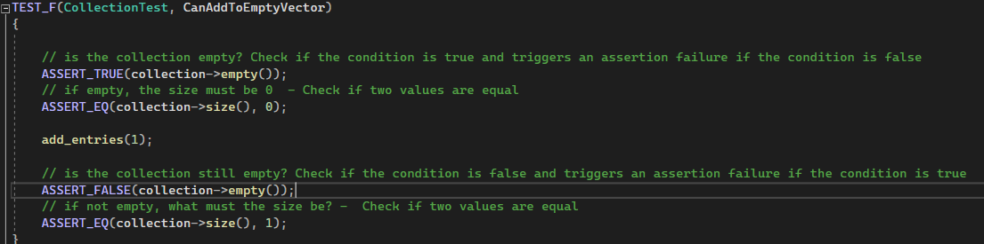
Unit Testing - CanAddToEmpyVector
Result

Slide 9
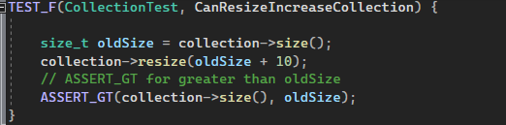
Unit Testing - CanReSizeIncreaseCollection
Result

Slide 10
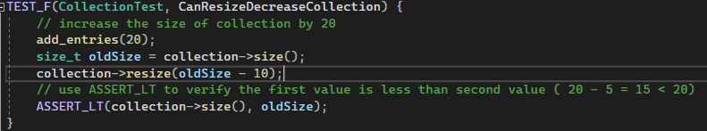
Unit Testing - CanResizeDecreaseCollection
Result

Slide 11
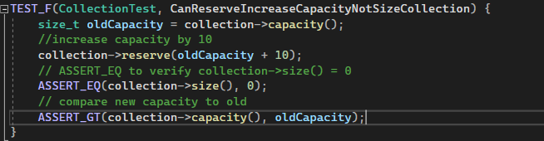
Unit Testing - CanReserveIncreaseCapacityNotSizeCollection
Result

Slide 12
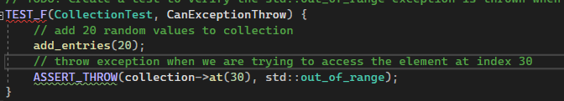
Unit Testing - CanExceptionThrow
Result

Slide 13

AUTOMATION SUMMARY
In the pre-production phase, we start to assess and plan security test driven design at an early stage of the development cycle to ensure the final build is more securable. By following OWASP best practices, we can integrate proper security tools in our development pipeline to check for any issues or vulnerability at the testing stage; in order to have a smooth transition at the deployment stage.
Since the security test has already produced at the design stage, we can monitor and detect any abnormal behavior towards the end of deployment, so we can respond to the attacks accordingly. By using correct coding standards implementation, we can reduce risk of security breach as well as data breach if the system is compromised

Slide 14
TOOLS
DevSecOps pipeline is a method of integrating security tools throughout the software development cycle from planning, building to the maintaining phase.
External tools such as:
OWASP Dependency-Check for building
BDD Automated Security Tests for testing
Osquery for deploying
Imperva RASP for monitoring

Slide 15
RISKS AND BENEFITS
There is a catch between integrate security tools as we go or wait until the end of the development.
If we act now can minimize the risk of assessment and management. It’s also reinforce our immediate response to be more responsive to threats and attacks. The catch is time and cost will be proportional to our software development cycle.
If we wait until the end, we will get a lots of performance issue, security breach, regulatory violation, and even more vulnerabilities due to lack of implementation of security policies as well as making a taint to our organization’s reputation

Slide 16
RECOMMENDATIONS
Beside improper security policy implementation throughout the software development cycle. Inadequate secure coding combined with the insufficient security training is also contribute to the slow response to external threats of intrusion.
Sony hack in 2014 is a perfect example in this case, insufficient defense in depth implementation for multiple security layers with no immediate response plan is contributed to the successful external intrusion.
Recommendations: Multiple layers of security should be applied to your network infrastructure to integrate security tools and to implement security policy should start from pre-production to production to prevent active attack and passive attack

Slide 17
CONCLUSIONS
Adhere to CERT C++/C coding standard to develop a safe and secure system for future proofing including performance wise for efficiency, lessen the impact of adverse events due to security threats, maintain a stable program at the monitoring stage towards of the end of production phase
As we go through functions, methods, classes in the coding structure, best practice is to follow each section in the list of CERT to check for any insecure part of the project.

Slide 18
REFERENCES
Introduction - SEI CERT C++ Coding Standard - Confluence. (2017). Cmu.edu. https://wiki.sei.cmu.edu/confluence/display/cplusplus/Introduction
‌Atlassian. (2023). DevSecOps Tools | Atlassian. Atlassian. https://www.atlassian.com/devops/devops-tools/devsecops-tools
‌What is Information Security | Policy, Principles & Threats | Imperva. (2023, March 14). Learning Center. https://www.imperva.com/learn/data-security/information-security-infosec/
‌Emily St. James, & Lee, T. B. (2015, January 20). The 2014 Sony hacks, explained. Vox; Vox. https://www.vox.com/2015/1/20/18089084/sony-hack-north-korea

